Slide 1
Genitourinary system physiopathology
Daryadokht Masror
Senior lecturer, IUMS faculty member
BS, MS, Dip in Soc Sci & NZRN
DaryadokhtMasror@gmail.com

Slide 2
The genitourinary system,
or urogenital system, are the organs of the reproductive system and the urinary system

Slide 3
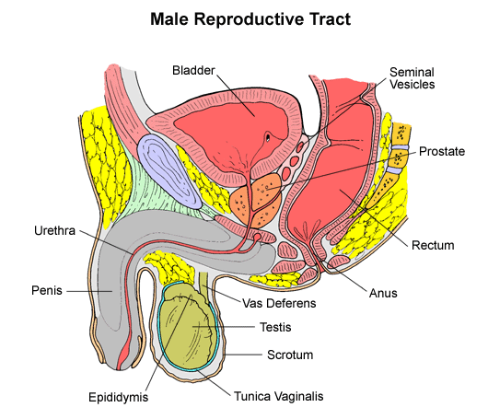

Slide 4
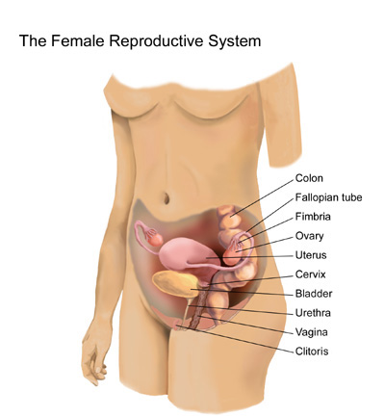

Slide 5
physiology
These are grouped together because of their proximity to each other, their common embryological origin
and the use of common pathways, like the male urethra.
Also, the systems are sometimes imaged together.

Slide 6
Development
The permanent organs of the adult are preceded by a set of structures that are purely embryonic and disappear almost entirely before the end of fetal life.
These embryonic structures are on either side: the pronephros, the mesonephric and the metanephros of the kidney, and the Wolffian (male) and Müllerian ducts (female) of the sex organ.
Some of the tubules of the mesonephric form part of the permanent kidney.

Slide 7
genitourinary pathology
As a medical specialty,
surgical pathology which deals with the diagnosis
and characterization of neoplastic
and non-neoplastic diseases of the urinary tract, male genital tract and testes.
However, Genitourinary pathologists generally work closely with urologic surgeons.

Slide 8
NORMAL URINE TRANSPORT AND MICTURITION
Urine production is a function of both renal-glomerular filtration and tubular reabsorption and is tightly regulated by systemic hydration state and electrolyte balance.
Urinary filtrate is passed through the nephron as it winds through the cortex and medulla and is concentrated via a counter-current mechanism.
Urine exits the kidney at the renal papillae and is transported through the upper collecting system.
The smooth muscle surrounding the calyces, renal pelvis, and ureters.

Slide 9
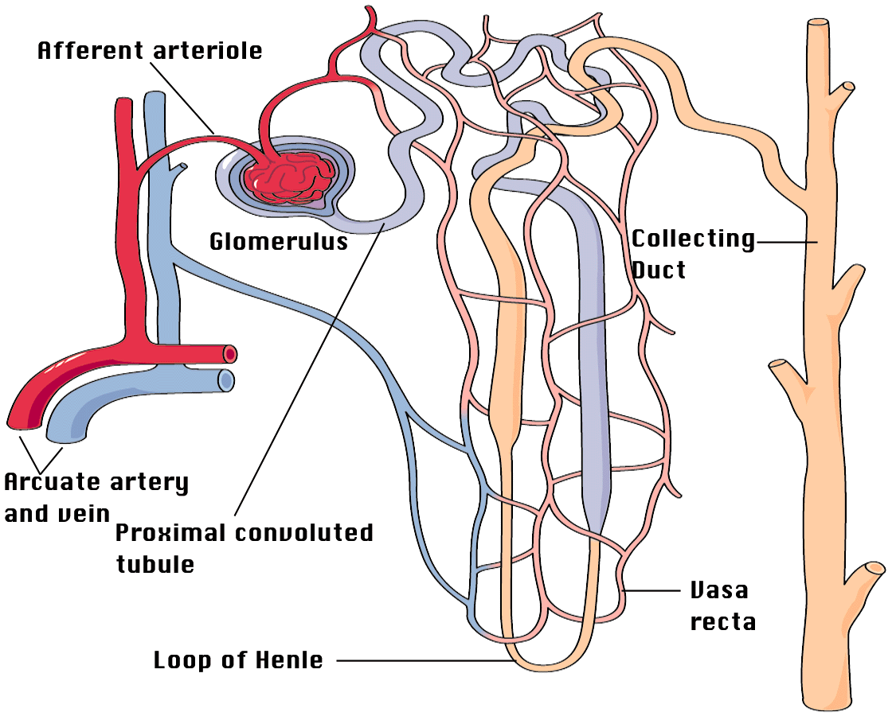
Steps involved in renal function
1) Blood from the
renal arteries is
delivered to the
glomeruli
4) Final
tubular
fluid -
Urine -
leaves
the kidney,
draining
into the
pelvis,
ureter,
bladder and
excreted via
the
urethra
2) Glomeruli
form an ultra-
filtrate which
flows into the
renal tubules
3) Tubules reabsorb/secrete solute
and water from ultra filtrate

Slide 10
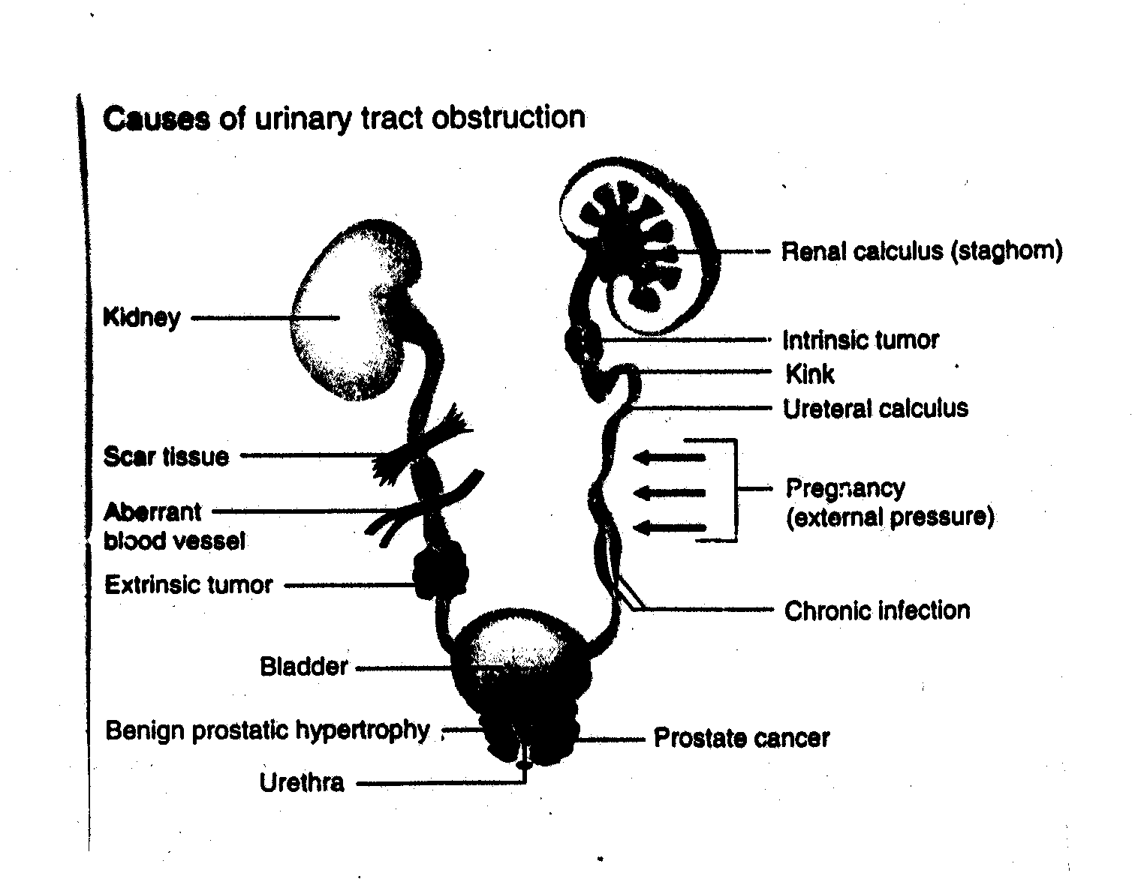

Slide 11
Disorders of the genitourinary system
Causes for these disorders include:
congenital anomalies,
infectious diseases,
trauma,
or conditions that secondarily involve the urinary structure.
To gain access to the body, pathogens can penetrate mucous membranes lining the genitourinary tract.

Slide 12
1-Urogenital malformations include:
Hypospadias
Epispadias
Labial fusion
Varicocele

Slide 13
Hypospadias
is a condition in which the opening of the urethra is on the underside of the penis instead of at the tip.
The location of the opening can vary and can be anywhere from underneath the tip of the penis (more common) to the base of the penis (less common).

Slide 14
Epispadias
is a rare birth defect located at the opening of the urethra.
In this condition, the urethra does not develop into a full tube, and the urine exits the body from an abnormal location.
The causes of epispadias are unknown.
It may be related to improper development of the pubic bone.

Slide 15
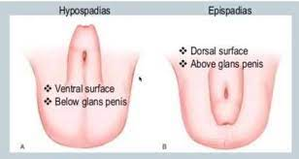

Slide 16
Labial fusion
is a condition where the two flaps of skin on either side of the opening to the vagina (the labia minora) are joined together.
It is also sometimes called labial adhesion or agglutination.
Labial fusion is a common condition, and there is no need for concern in most cases.

Slide 17
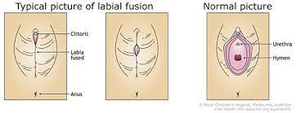

Slide 18
varicocele
is an enlargement of the veins within the loose bag of skin that holds in testicles (scrotum).
is similar to a varicose vein and might see in leg.
Varicoceles are a common cause of low sperm production and decreased sperm quality, which can cause infertility.

Slide 19
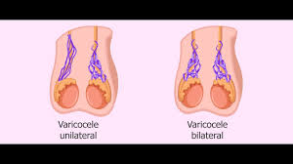

Slide 20
Anatomic & pathophysiology abnormalities
2- Medullary Sponge Kidney (MSK)
is a renal disorder that is characterized by distal collecting-duct dilatation and multiple cysts and diverticula within the renal medullary pyramids.
It is associated with a higher risk of nephrocalcinosis, urolithiasis, renal failure, and UTI
The prevalence:
- of this disorder in the general population is unknown.

Slide 21
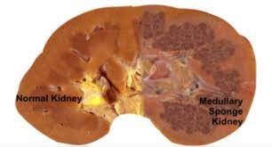

Slide 22
Anatomic & pathophysiology abnormalities
3-Calyceal Diverticula
is a congenital, urothelial-lined cavity within the renal parenchyma.
They are relatively uncommon,
Urine moves passively in a retrograde manner through narrow to fill the diverticulum
Additionally, obstruction at the diverticular neck can lead to rupture and haemorrhage, abscess formation, and potentially life-threatening sepsis.

Slide 23
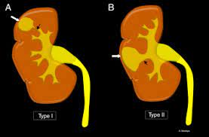

Slide 24
Anatomic & pathophysiology abnormalities
4-Ureteral Obstruction
Obstruction of the ureters can cause urinary stasis
and, in severe cases, renal dysfunction; both of which are risk factors for UTI.

Slide 25
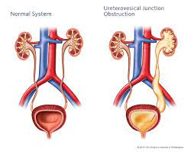

Slide 26
Anatomic & pathophysiology abnormalities
5- Primary Vesicoureteral Reflux (VUR)
Primary VUR is defined by the retrograde flow of urine, from bladder to the upper urinary tract, in the absence of obvious pathogenic cause.
(families containing sibling pairs with documented VUR & reflux nephropathy)

Slide 27
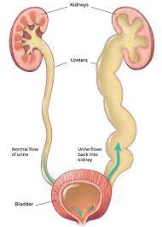

Slide 28
Anatomic & pathophysiology abnormalities
6- Bladder-Outlet Obstruction(BOO)
in men can develop for a number of reasons including:
- bladder calculi,
medications,
prostate cancer,
urethral scarring,
and benign prostatic hyperplasia (BPH).
While most causes for BOO are relatively uncommon, BPH will develop in nearly all men by the age of 80.

Slide 29
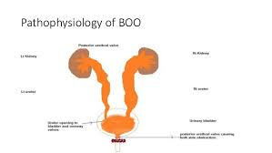

Slide 30
Anatomic & pathophysiology abnormalities 6- Bladder-Outlet Obstruction
it cause for urinary retention secondary to BOO increases UTI risk.
7- Chronic urinary retention is defined as a non-painful bladder that remains palpable or percuss able after urination and implies a significant residual volume of urine greater than 300 ml.
Chronic urinary retention but incidence increases dramatically with age, lower urinary tract symptom severity, and prostate volume.

Slide 31
Anatomic & pathophysiology abnormalities
7- Abnormal Pelvic Anatomy
Pelvic disorders, such as:
- pelvic floor dysfunction,
pelvic inflammatory disease (PID)
and pelvic organ prolapse,
are conditions that affect the pelvis, the basin-shaped structure that supports the spinal column and protects the abdominal organs.
Causes of pelvic disorders vary depending on the type of disease.

Slide 32
pelvic floor urinary problems?
The symptoms of a pelvic floor dysfunction include:
leaking urine when coughing,
sneezing, laughing or running
failing to reach the toilet in time.

Slide 33
What treats diseases affecting the pelvic floor including the bladder?
Urogynecologists treat pelvic organ prolapse,
urinary incontinence,
fecal incontinence
and other pelvic floor disorders.

Slide 34
What is the most effective treatment for the pelvic floor?
effectively treated with a variety of physical therapy techniques, including:
manual therapy,
biofeedback,
relaxation training,
electrical stimulation,
and medication In contrast,
Kegel's exercise may exacerbate the pain

Slide 35
manual therapy
involves the PT using hands-on pressure and massage, either externally or internally, on the muscles of the pelvis.
Manual therapy is useful for improving blood flow to the affected muscles, as well as helping those muscles to stretch and relax.

Slide 36
OTHER Anatomic & pathophysiology abnormalities
8-Aging Female
The prevalence of UTI has been shown to increase with age.
Anatomic and functional theories to explain this phenomenon include:
bladder dysfunction,
pelvic organ prolapse,
urinary and fecal incontinence,
and changes in oestrogen status.

Slide 37
Other Anatomic & pathophysiology abnormalities
9-Diabetes Mellitus
Individuals with diabetes mellitus are at a high risk for UTI and RUTIs.
Epidemiologic studies show a 1.2 to 2.2-fold increase in the relative risk of UTI in diabetics when compared with non-diabetics.

Slide 38
Other Anatomic & pathophysiology abnormalities
10-Pregnancy
The prevalence of bacteriuria in pregnancy is similar to non-gravid females and ranges from 2% to 10%.
However, 25% to 35% of pregnant woman with bacteriuria will progress to pyelonephritis

Slide 39
Other Anatomic & pathophysiology abnormalities
11-Ureter pelvic-Junction Obstruction(UPJO)
is the most common cause of obstructive nephropathy in children with an estimated incidence of 1 in 1,000–1,500.
The widespread use of prenatal screening ultrasonography has led to the early detection of hydro nephrosis and, subsequently, the majority of UPJO are diagnosed in the neonatal and infant period.
UPJO and urinary stasis are generally considered an indication for either antibiotic prophylaxis and/or surgical correction.

Slide 40
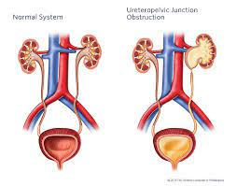

Slide 41
Other Anatomic & pathophysiology abnormalities
12-Dysfunctional Voiding (DV)
is characterized by an intermittent and/or fluctuating flow rate due to involuntary intermittent contractions of the peri-urethral muscles during voiding in neurologically normal individuals.
The prevalence of adult DV is unknown.
In patients referred for urodynamic evaluation,
in women with both DV and recurrent UTI, pelvic-floor physiotherapy can significantly reduce the rate of UTI recurrence.

Slide 42
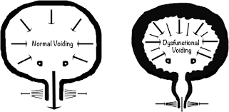

Slide 43
Other Anatomic & pathophysiology abnormalities
13-Primary Bladder-Neck Obstruction (PBNO)
is a condition in which the flow of urine is obstructed due to incomplete bladder-neck opening.
Diagnostic:
- features of PBNO include high-voiding pressures and low urine flow.
Treatment options for PBNO include:
- observation,
pharmacotherapy,
and surgical intervention.
Obstruction of urine flow at the bladder neck can lead to elevated PVR and presumably increase the risk of UTI.

Slide 44
Other Anatomic & pathophysiology abnormalities
14-Neurologic Patients
Individuals with suprasacral and sub pontine spinal-cord injuries develop bladder over activity and involuntary contractions of the external urinary sphincter.
The resulting detrusor-external sphincter dyssynergia (DESD),

Slide 45
Neurologic Patients 15-Detrusor-External Sphincter Dyssynergia (DESD),
can lead to dangerously high storage pressures and the development of serious urologic and nephrologic complications including secondary VUR, incomplete bladder emptying, bacteriuria, and recurrent UTI.
Ideally, a combination of clean intermittent catheterization (CIC)

Slide 46
Neurologic Patients 15-Detrusor-External Sphincter Dyssynergia (DESD),
and anticholinergic medications are used to reduce intravesical storage pressures and allow for bladder emptying
Alternative treatments may be needed for those who cannot tolerate anticholinergic agents or cannot reliably catheterize (e.g., quadriplegic or non-compliant patients).

Slide 47
SUMMARY
The ability of the urinary tract to defend against microbial infections relies on its normal anatomic architecture as well as a functional physiological state.
Defects in either or both aspects, whether they be congenital or acquired, can increase the access, retention, and spread, and the decreased clearance of microbes from the urinary tract, leading to microbial infections and even recurrent episodes.
A thorough understanding of anatomy and physiology of the urinary tract is therefore necessary for those who investigate and those who diagnose and treat urinary tract infections.

